Slide 1
Train with python. Predict with C++
Pavel Filonov, C++ Siberia 2019

Slide 2
Machine Learning everywhere!
Mobile
Embedded
Automotive
Desktops
Games
Finance
Etc.
Image from [1]

Slide 3
Dream team
Developer
Data Scientist

Slide 4
Dream team – synergy way
Developer
Data Scientist
Research Developer

Slide 5
Dream team – process way
Communications
Developer
Data Scientist

Slide 6
Machine learning sample cases
Energy efficiency prediction
Intrusion detection system
Image classification

Slide 7
Buildings Energy Efficiency
Input attributes
Relative Compactness
Surface Area
Wall Area
etc.
Outcomes
Heating Load
ref: [2]

Slide 8
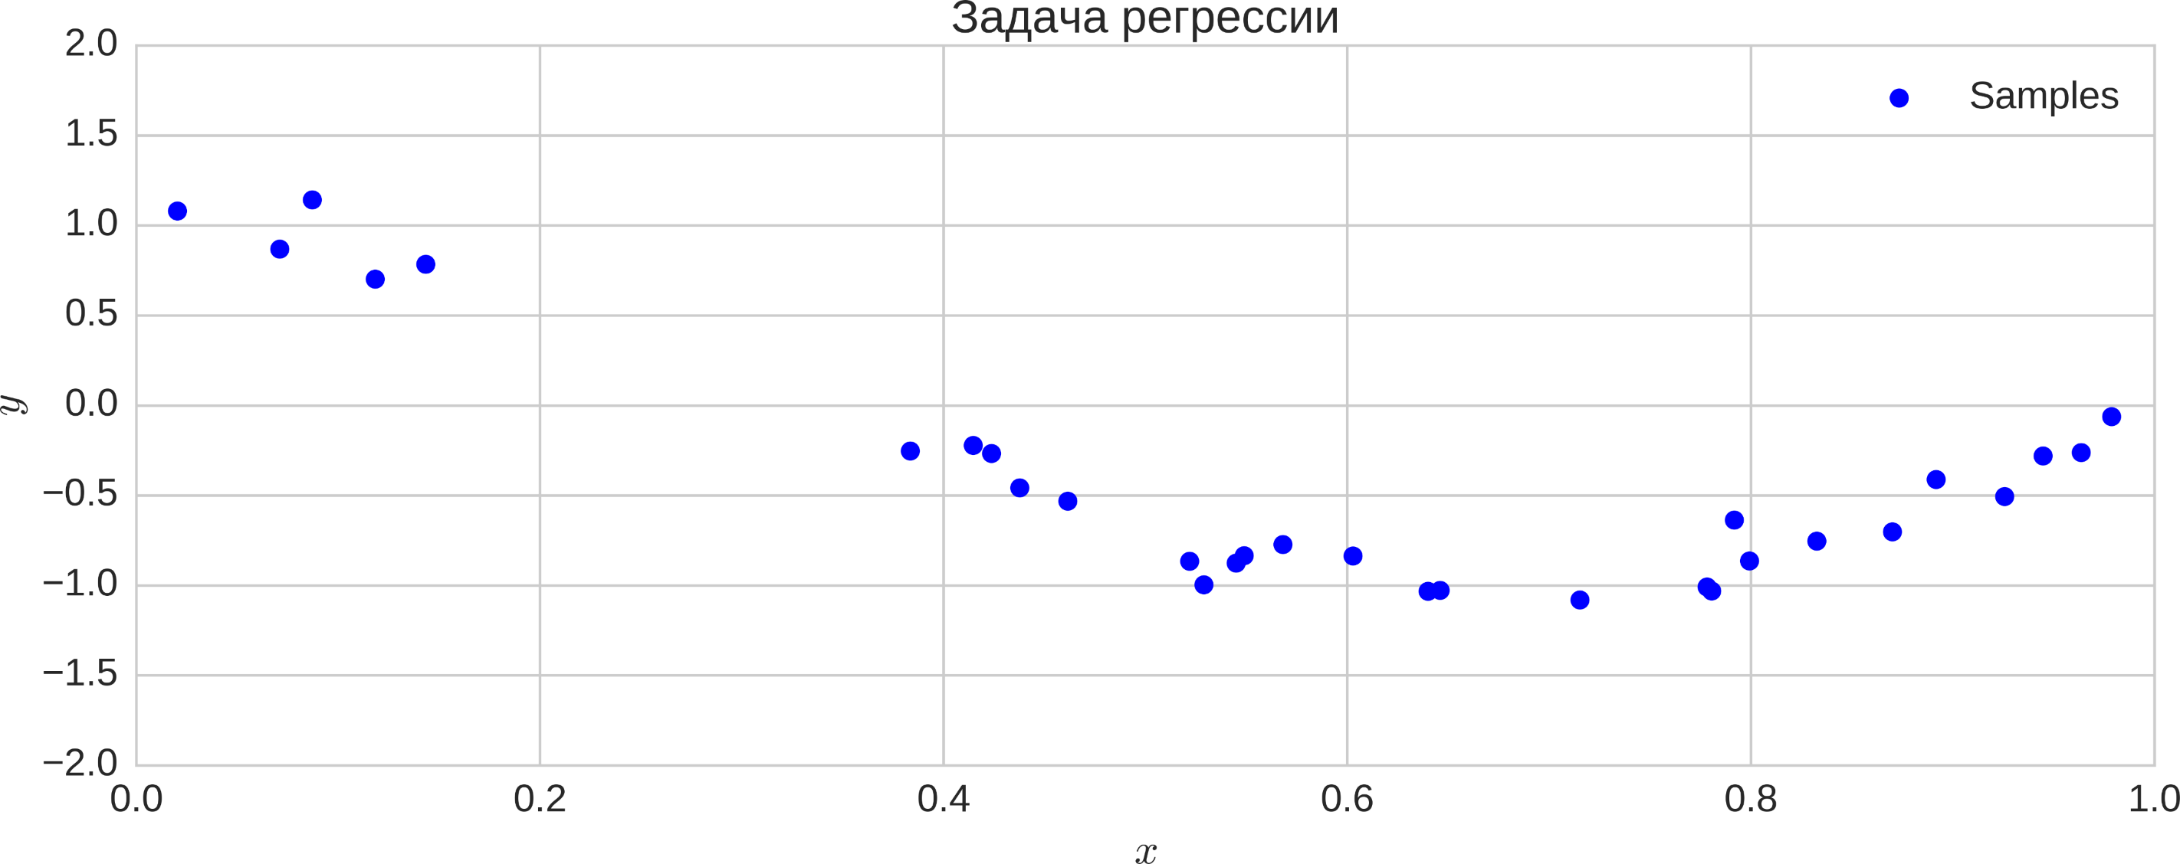
Regression problem

Slide 9
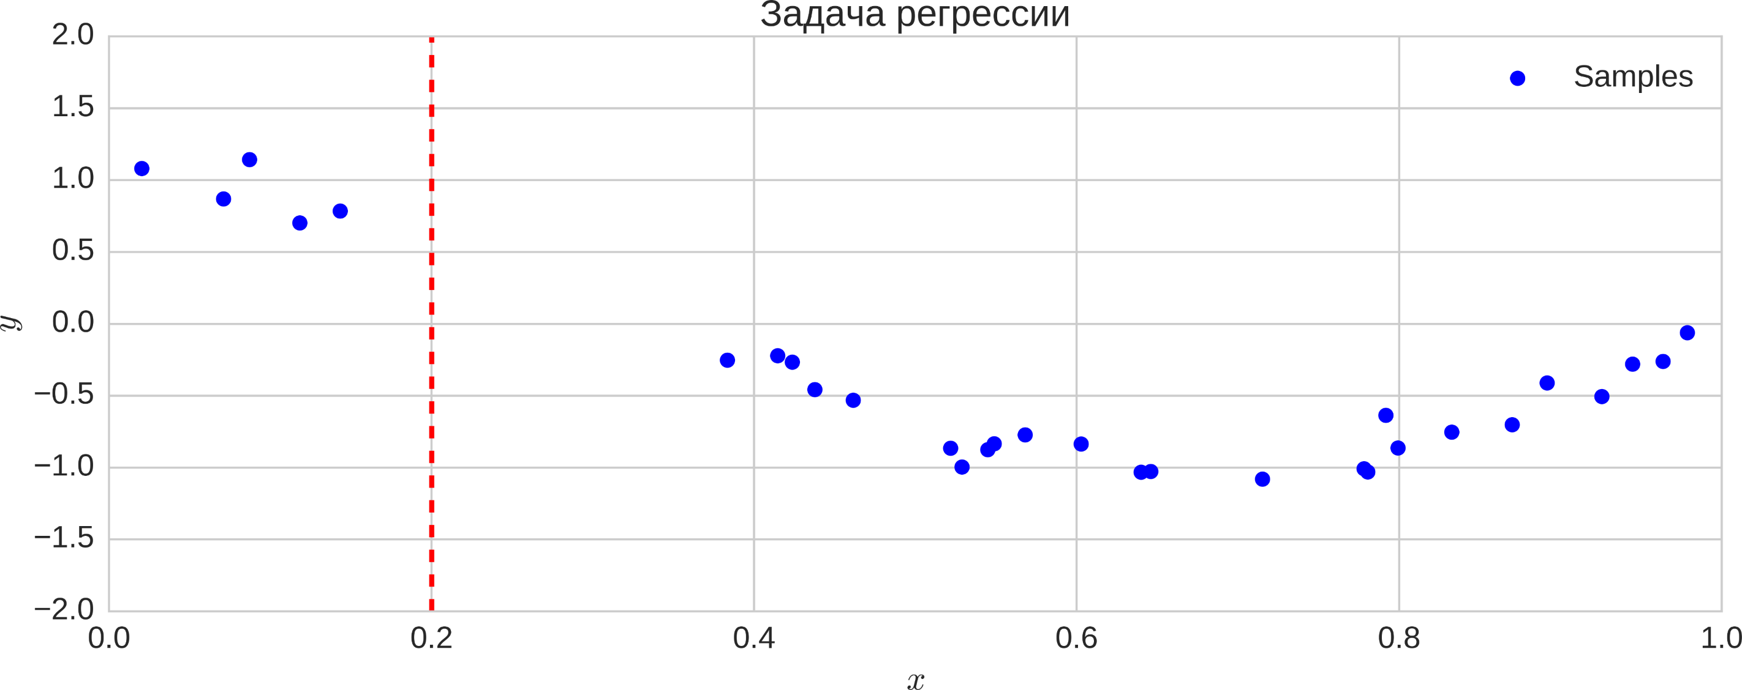
Regression problem

Slide 10
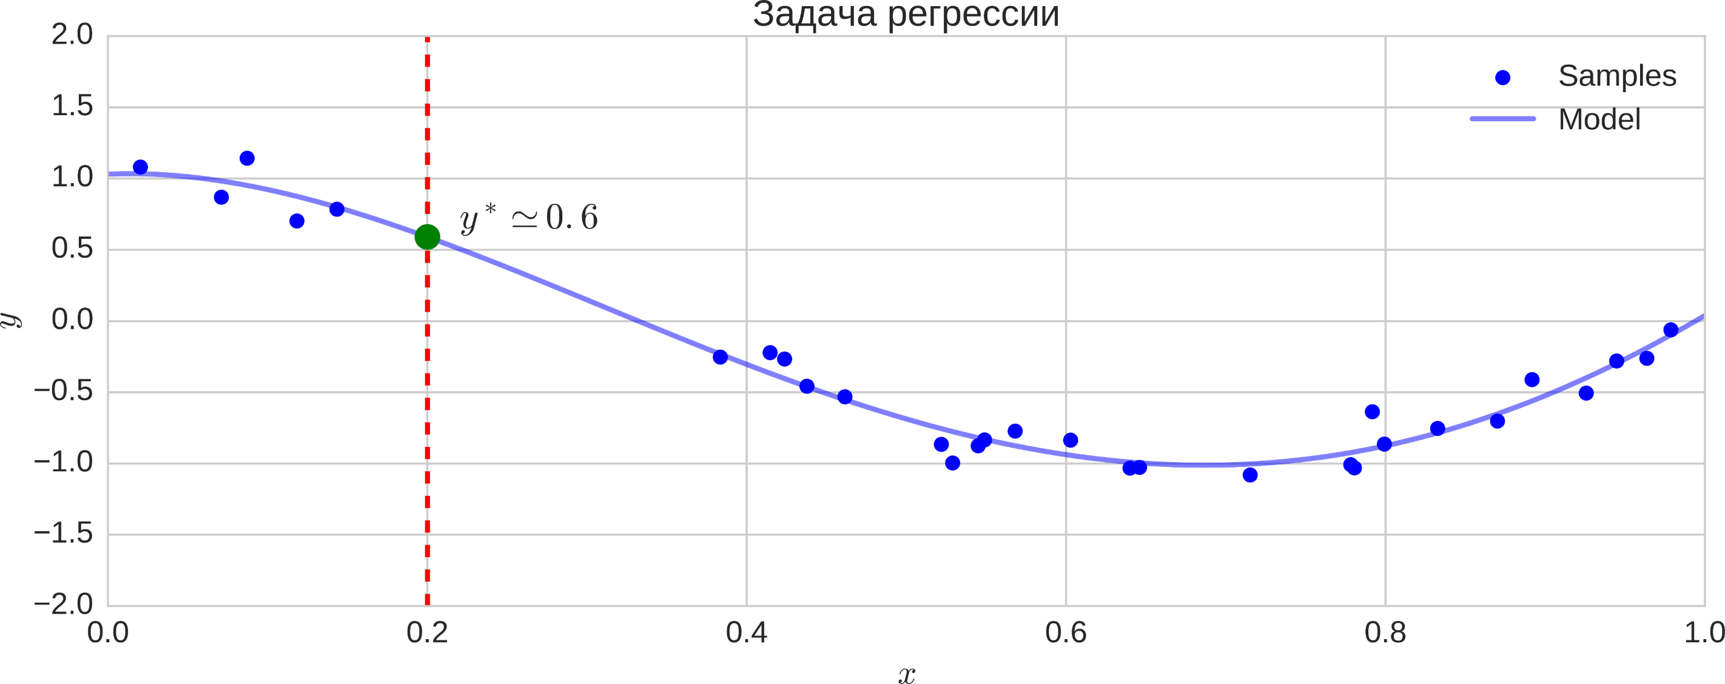
Regression problem

Slide 11
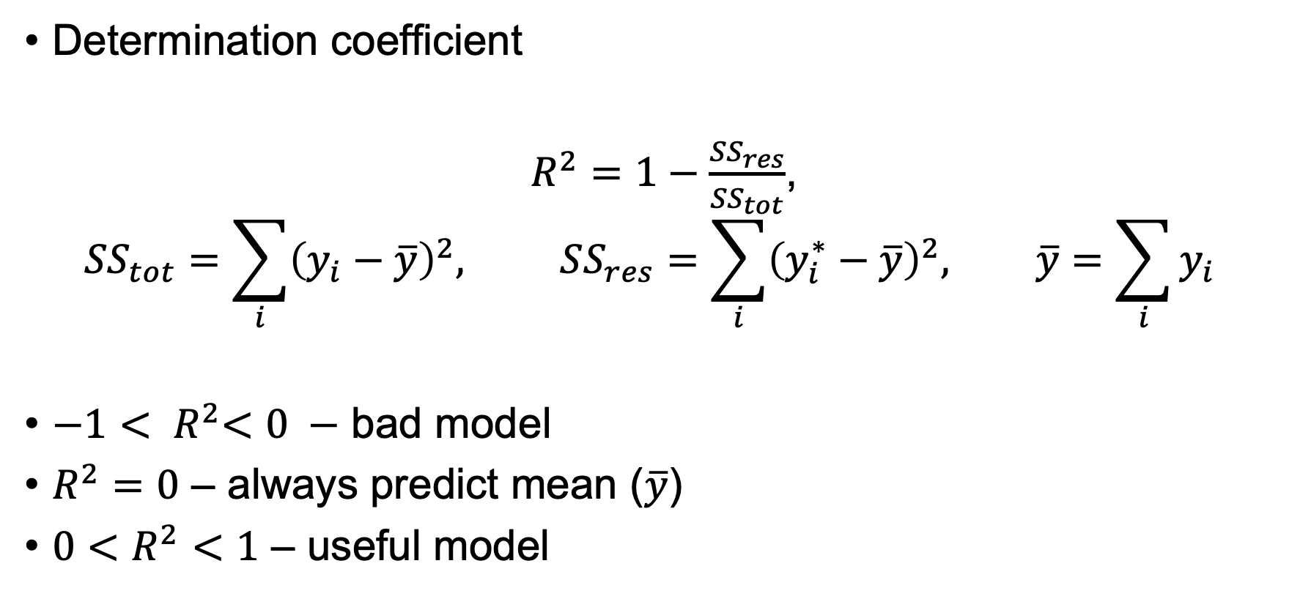
Quality metric
Determination coefficient
$R^{2}=1−\frac{{SS}_{res}}{{SS}_{tot}}$,
$${SS}_{tot}=\sum_{i}{{\left(y_{i}−\overline{y}\right)}^{2}, SS_{res}=\sum_{i}{{\left(y_{i}^{∗}−\overline{y}\right)}^{2}, \overline{y}=\sum_{i}{y_{i}}}}$$
${−1< R}^{2}<0 −$ bad model
$R^{2}=0$ – always predict mean ($\overline{y}$)
$0<R^{2}<1$ – useful model

Slide 12
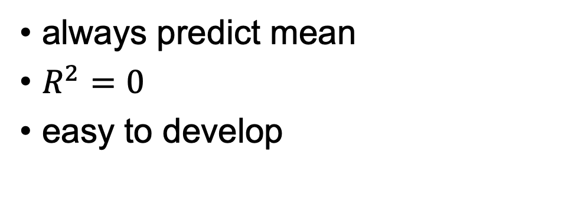
Baseline model
always predict mean
$R^{2}=0$
easy to develop
class Predictor {
public:
using features = std::vector<double>;
virtual ~Predictor() {};
virtual double predict(const features&) const = 0;
};
class MeanPredictor: public Predictor {
public:
MeanPredictor(double mean);
double predict(const features&) const override { return mean_; }
protected:
double mean_;
};

Slide 13
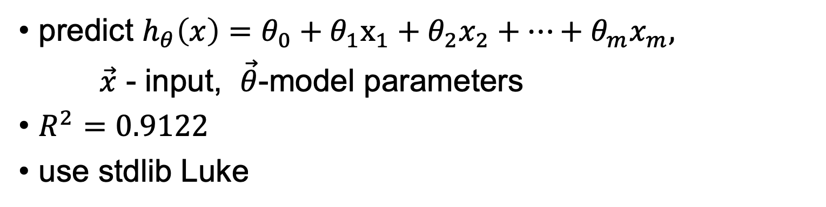
Linear regression
predict $h_{θ}\left(x\right)=θ_{0}+θ_{1}x_{1}+θ_{2}x_{2}+…+θ_{m}x_{m},$
$\vec{x}$ - input, $\vec{θ}$-model parameters
$R^{2}=0.9122$
use stdlib Luke
class LinregPredictor: public Predictor {
public:
LinregPredictor(const std::vector<double>&);
double predict(const features& feat) const override {
assert(feat.size() + 1 == coef_.size());
return std::inner_product(feat.begin(), feat.end(), ++coef_.begin(), coef_.front());
}
protected:
std::vector<double> coef_;
};

Slide 14
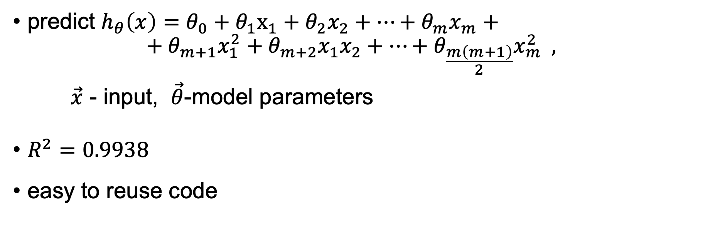
Polynomial regression
predict $h_{θ}\left(x\right)=θ_{0}+θ_{1}x_{1}+θ_{2}x_{2}+…+θ_{m}x_{m}+$ ${+ θ}_{m+1}x_{1}^{2}+θ_{m+2}x_{1}x_{2}+…+θ_{\frac{m\left(m+1\right)}{2}}x_{m}^{2} ,$
$\vec{x}$ - input, $\vec{θ}$-model parameters
$R^{2}=0.9938$
easy to reuse code

Slide 15
Polynomial regression
class PolyPredictor: public LinregPredictor {
public:
using LinregPredictor::LinregPredictor;
double predict(const features& feat) const override {
features poly_feat{feat};
const auto m = feat.size();
poly_feat.reserve(m*(m+1)/2);
for (size_t i = 0; i < m; ++i) {
for (size_t j = i; j < m; ++j) {
poly_feat.push_back(feat[i]*feat[j]);
}
}
return LinregPredictor::predict(poly_feat);
}
};

Slide 16
Integration testing
you always have a lot of data for testing
use python model output as expected values
beware of floating point arithmetic problems
TEST(LinregPredictor, compare_to_python) {
auto predictor = LinregPredictor{coef};
double y_pred_expected = 0.0;
std::ifstream test_data{"../train/test_data_linreg.csv"};
while (read_features(test_data, features)) {
test_data >> y_pred_expected;
auto y_pred = predictor.predict(features);
EXPECT_NEAR(y_pred_expected, y_pred, 1e-4);
}
}

Slide 17
Intrusion detection system
input - network traffic features
protocol_type
connection duration
src_bytes
dst_bytes
etc.
Output
normal
network attack
ref: [3]

Slide 18
Classification problem

Slide 19
Quality metrics
Receive operation characteristics (ROC) curve

Slide 20
Baseline model
always predict most frequent class
ROC area under the curve = 0.5

Slide 21
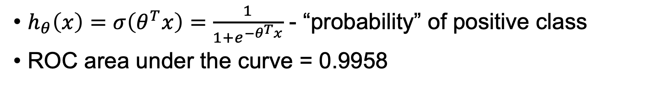
Logistic regression
$h_{θ}\left(x\right)=σ\left(θ^{T}x\right)=\frac{1}{1+e^{−θ^{T}x}}$ - “probability” of positive class
ROC area under the curve = 0.9958

Slide 22
Logistic regression
easy to implement
template<typename T>
auto sigma(T z) {
return 1/(1 + std::exp(-z));
}
class LogregClassifier: public BinaryClassifier {
public:
float predict_proba(const features_t& feat) const override {
auto z = std::inner_product(feat.begin(), feat.end(), ++coef_.begin(), coef_.front());
return sigma(z);
}
protected:
std::vector<float> coef_;
};

Slide 23
Gradient boosting
de facto standard universal method
multiple well known C++ implementations with python bindings
XGBoost
LigthGBM
CatBoost
each implementation has its own custom model format

Slide 24
CatBoost
C API and C++ wrapper
own build system (ymake)
class CatboostClassifier: public BinaryClassifier {
public:
CatboostClassifier(const std::string& modepath);
~CatboostClassifier() override;
double predict_proba(const features_t& feat) const override {
double result = 0.0;
if (!CalcModelPredictionSingle(model_, feat.data(), feat.size(), nullptr, 0, &result, 1)) {
throw std::runtime_error{"CalcModelPredictionFlat error message:" + GetErrorString()};
}
return result;
}
private:
ModelCalcerHandle* model_;
}

Slide 25
CatBoost
ROC-AUC = 0.9999

Slide 26
Image classification
Handwritten digits recognizer – MNIST
input – gray-scale pixels 28x28
output – digit on picture (0, 1, … 9)

Slide 27
Multilayer perceptron
Image from: [4]

Slide 28
Quality metrics
$Accuracy=\frac{correct}{total}$

Slide 29
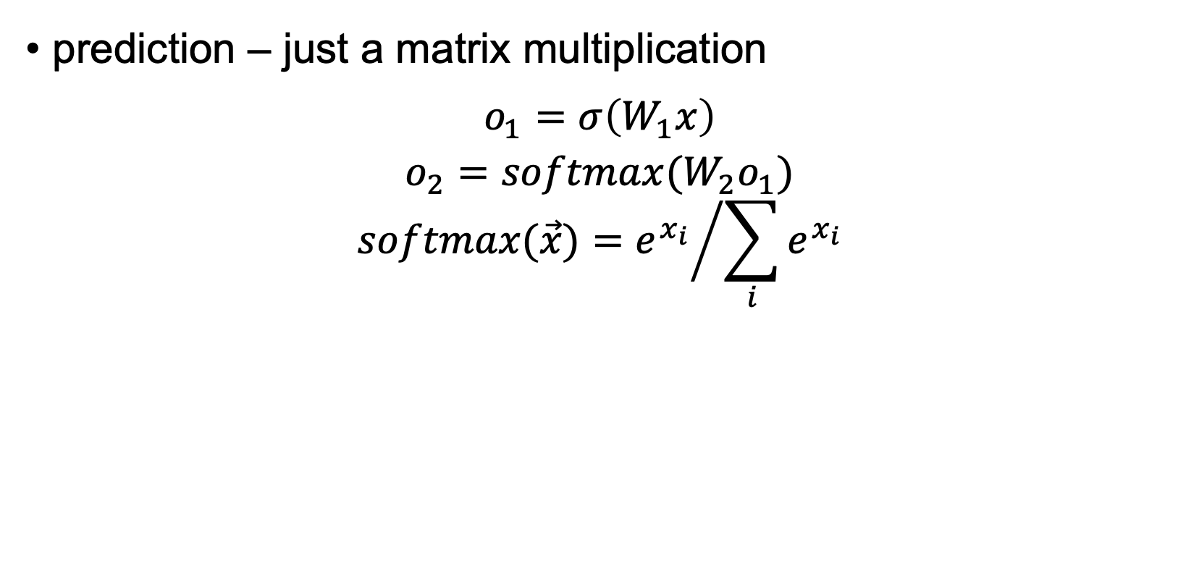
Multilayer perceptron
prediction – just a matrix multiplication
$$o_{1}=σ\left(W_{1}x\right)$$
$$o_{2}=softmax(W_{2}o_{1})$$
$$softmax(\vec{x})={e^{x_{i}}}/{\sum_{i}{e^{x_{i}}}}$$
auto MlpClassifier::predict_proba(const features_t& feat) const {
VectorXf x{feat.size()};
auto o1 = sigmav(w1_ * x);
auto o2 = softmax(w2_ * o1);
return o2;
}

Slide 30
Convolutional networks
State of the Art algorithms in image processing
a lot of C++ implementation with python bindings
TensorFlow
Caffe
MXNet
CNTK

Slide 31
Tensorflow
C++ API
Bazel build system
Hint – prebuild C API

Slide 32
Conclusion
Don’t be fear of the ML
Try simpler things first
Get benefits from different languages

Slide 33
References
Andrew Ng, Machine Learning – coursera
Energy efficiency Data Set
KDD Cup 1999
MNIST training with Multi Layer Perceptron
Code samples

Slide 34
Let’s Talk?

